Slide 1
SOFTECH
ANALYSIS REPORT

Slide 2
INTRODUCTION
This semester course “Software Engineering” has required of us to use the knowledge we have acquired from the previous courses and the current ones to build a working software that will help solve a problem.
Our group “SOFTECH” in our first meeting after considering all options chose to build a game.
The game we chose to build by the group’s decision, must be educative and fun enough to attract a larger market.
This gave birth to game called “NumberMan”.

Slide 3
Number Man (Game description)
Number Man is an android application (2.5D game) which helps individuals to sharpen their logic skills. The game is solely for checking efficiency not accuracy. It does this through the use of simple mathematical operations.
It is a game with the character “NumberMan” running on a platform containing obstacles.
The game features four keys on which have numbers “1”, ”2”, “3”, and “4” written on it
The obstacles have numbers on them. When NumberMan encounter an obstacle, and the player is able to input the number on the obstacle, the character then over comes the obstacle else the game ends there and needs to restart again.

Slide 4
Requirement
Tools Used
Game engine: Unity – is a cross-plate form game engine developed by Unity Technologies and used to develop video games for PC, consoles, mobile devices and websites.
IDE: Visual basic
Language: C-Sharp
Design: Adobe Photoshop, Adobe Flash, Adobe Illustrator

Slide 5
References
IEEE standard by 830 – 1993
Youtube.com
Wikipedia – www.wikipedia.com
Technologies to be used
Google play services
Android SDK

Slide 6
Software Interface
Android OS
Minimum requirement:
Android 4.0 “ice cream sandwich” (API Level 14)
Recommendation:
Marshmallow (API Level 23)

Slide 7
Hardware Interface
Minimum requirement:
RAM = 512MB
Processor = Qualcomm – 1GHz dual-core, mediatek@1.2GHz dual-core
GPU = Adreno 230, Mali, power VR
Recommendation:
Qualcomm 2.46GHz quad-core
Clock Speed 300 MHz – 2.46 GHz

Slide 8
Communication Interface
Graphic User Interface (GUI)
Constraints
GUI is only in English
Optional Login
Software system attributes
Reliability:
Minimal system crashes.
Maintainability:
Regular bug fixes.

Slide 9
Questionnaire
The group did a verbal questionnaire in which the idea of NumberMan was shared to find out the opinions and expectations of customers about the game.
The data retrieved from our questionnaire shows that:
1. In every group of five high school students, an average of four have approved of the game
2. In every group of ten people(general public), an average of eight gave approval of the game
This indicates that the idea of NumberMan is a good one to implement.
Below is a picture of the group doing a verbal questionnaire

Slide 10
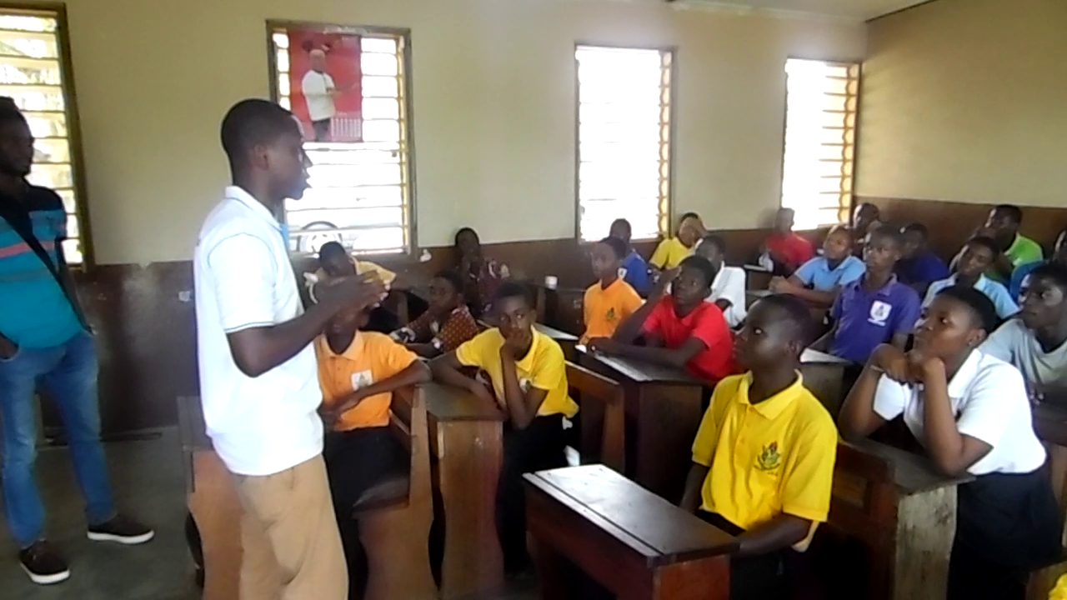

Slide 11
DESIGN AND MODELING
Beginning the project, the group have agreed to execute the project following the waterfall model. All project plans were based on this model.
But as the project transcends it beginning stage, challenges encountered has caused us to make transition to a different model
This is because even though we have planned to execute our work in phases, we realized that as we progress in the project, we kept coming back to integrate other features as well as fix errors that are encountered.
The design Model therefore, employed in this project is CODE AND FIX.

Slide 12
Modeling
The software used in the design and modeling of character, background, platform, obstacles and other features include:
1. Autodesk maya
2. Blender
3. Photoshop
Below are some of the pictures of what the game look like as we progress in the project.

Slide 13
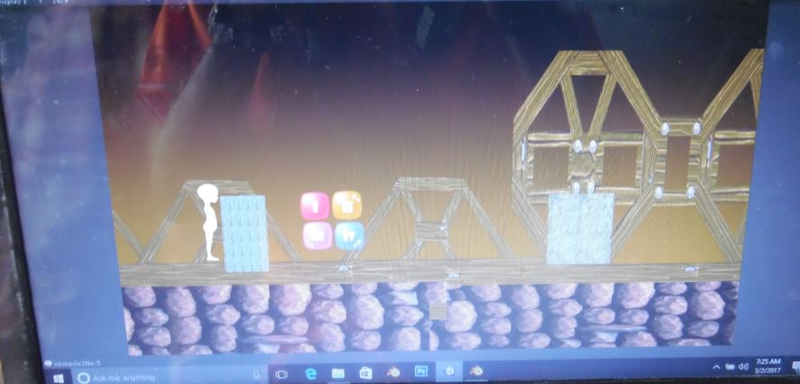
First prototype

Slide 14
Estimations
COCOMO estimation technique based on lines of code is used to get an accurate insight to project size, cost and effort needed to realize our project.
Lines of code:
Front-end = 1200
Website = 1535
Total lines of code = 2735 LOC = K2.735

Slide 15
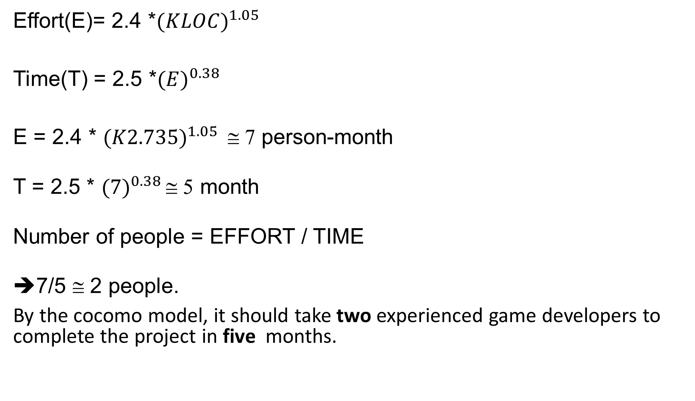
Effort(E)= 2.4 *${(KLOC)}^{1.05}$
Time(T) = 2.5 *${(E)}^{0.38}$
E = 2.4 * ${(K2.735)}^{1.05}$ ≅ 7 person-month
T = 2.5 * ${(7)}^{0.38}$ ≅ 5 month
Number of people = EFFORT / TIME
7/5 ≅ 2 people.
By the cocomo model, it should take two experienced game developers to complete the project in five months.

Slide 16
FINANCIAL BUDGET
Carefully examining the entire project, we came to realized that most of the tools we need for the project would not cost us any amount of money.
For hardware, we already have our laptop computers, and the software that we required we got it without purchasing them.
But against all odds, the group made available an amount of GH₵ 700.00 to cater for emergency cases.

Slide 17
EXPENSES
The total expenditure on the project is GH₵ 300.00
This cost came as a result of a crashed hard drive replacement for one of our programmers
Apart from this, no other cost have been incurred.

Slide 18
MEETING DOCUMENTATIONS
First Meeting
Date: 03/02/2017
Agenda: Idea deliberation, sampling and project selection
Second Meeting
Date: 05/02/2017
Agenda: Software requirement specification (SRS) document preparation

Slide 19
Third Meeting
Date: 11/02/2017
Agenda: questionnaire Analysis
Fourth Meeting
Date: 04/03/2017
Agenda: First app exhibition and evaluation

Slide 20
Fifth Meeting
Date: 18/03/2017
Agenda: Second app exhibition and Evaluation

Slide 21
THANK YOU

